Slide 1
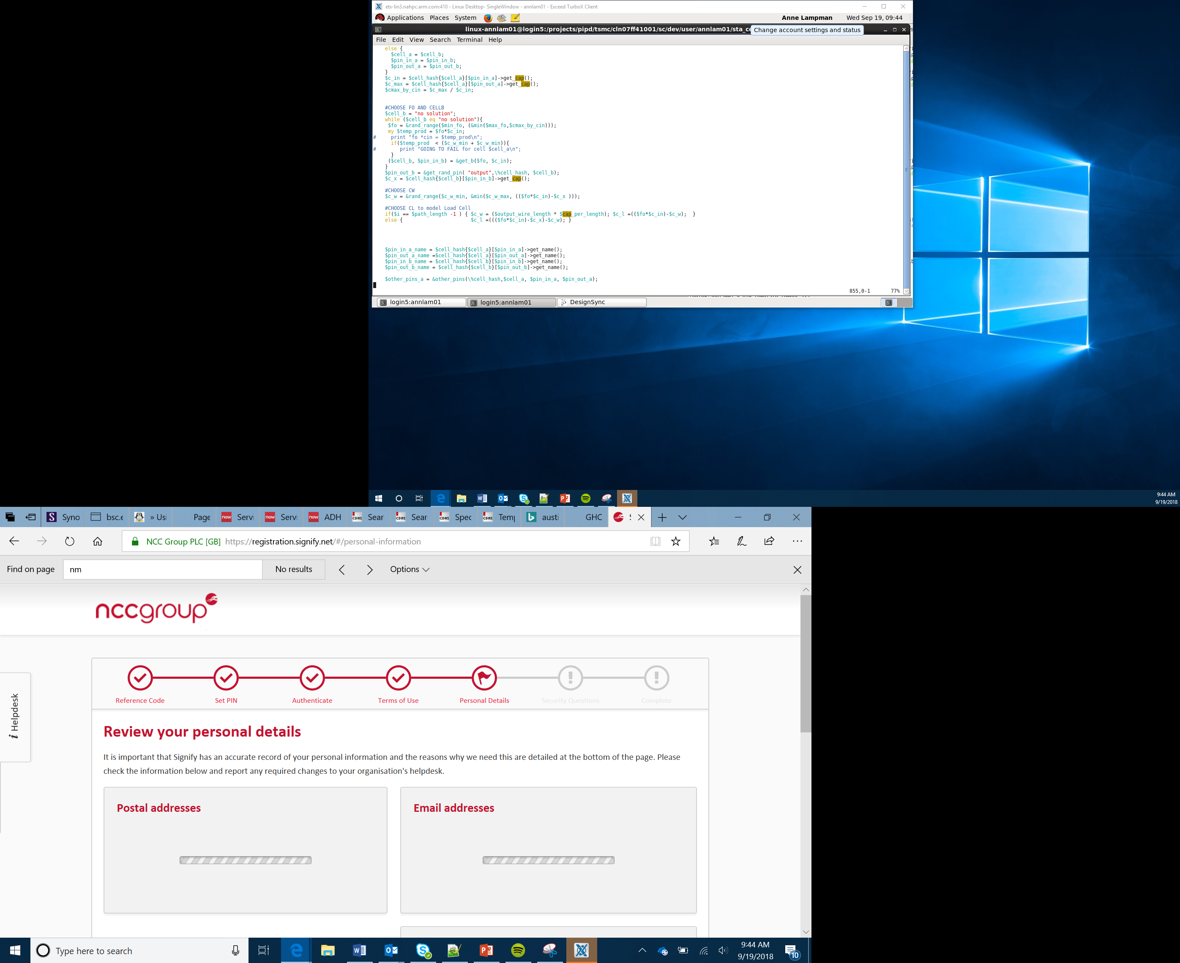

Making Music: Iteration
Lesson 10

Slide 2
Writing Efficient Code
When we write computer programs quite often we need to repeat certain instructions
Think about a platform game:
When the character or sprite moves it repeats the same instruction over and over
Rather than writing the same line of code over and over we can make it loop (repeat)
This makes it much faster to code and more efficient
The use of loops in computer programming is called iteration – the process of repeating something

Slide 3
Using the micro:bit to Make Music
Today you are going to produce your own piece of music using the MakeCode website
You are going to use the Music category

Slide 4
The micro:bit and Loops
When you first launch MakeCode there are two empty blocks:
on start – this block will run the code once and then stop
forever – this block is a loop and will run any code inside of it over and over

Slide 5
Making Music
The start melody block has been placed inside the on start block
You can select the melody to play by clicking on the dadadum dropdown
You can also make the code repeat by changing the once drop down
You should now work through the making music worksheet to produce your own piece of music
Notes:
Demonstrate this program to learners on the MakeCode website. This will ensure that they are aware of where they can locate the sound commands. It will help to generate interest.

Slide 6
micro:pet Project

Slide 7
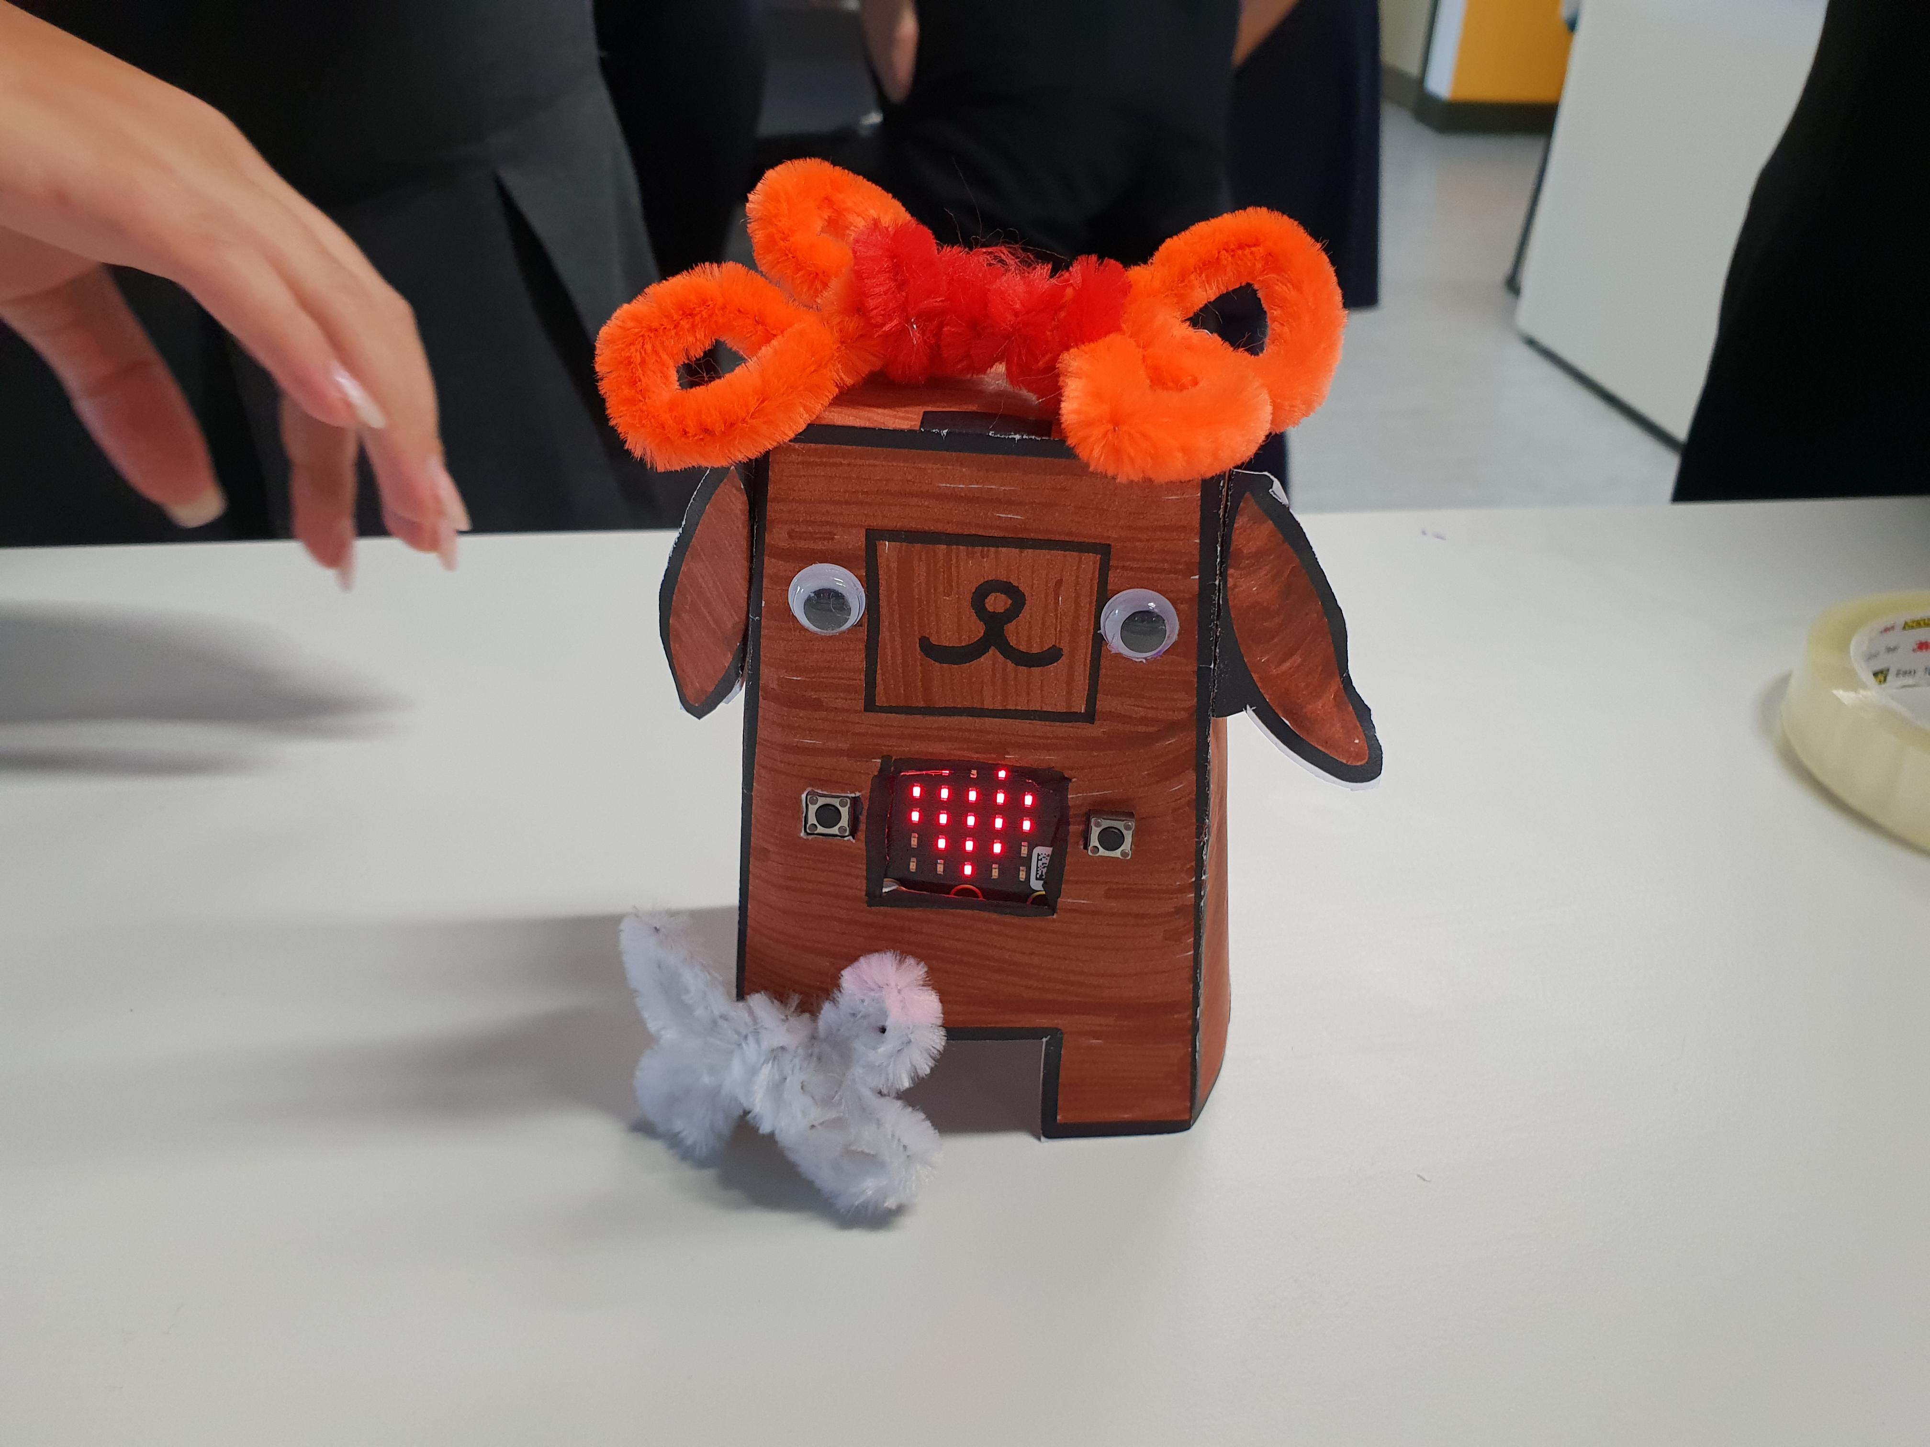
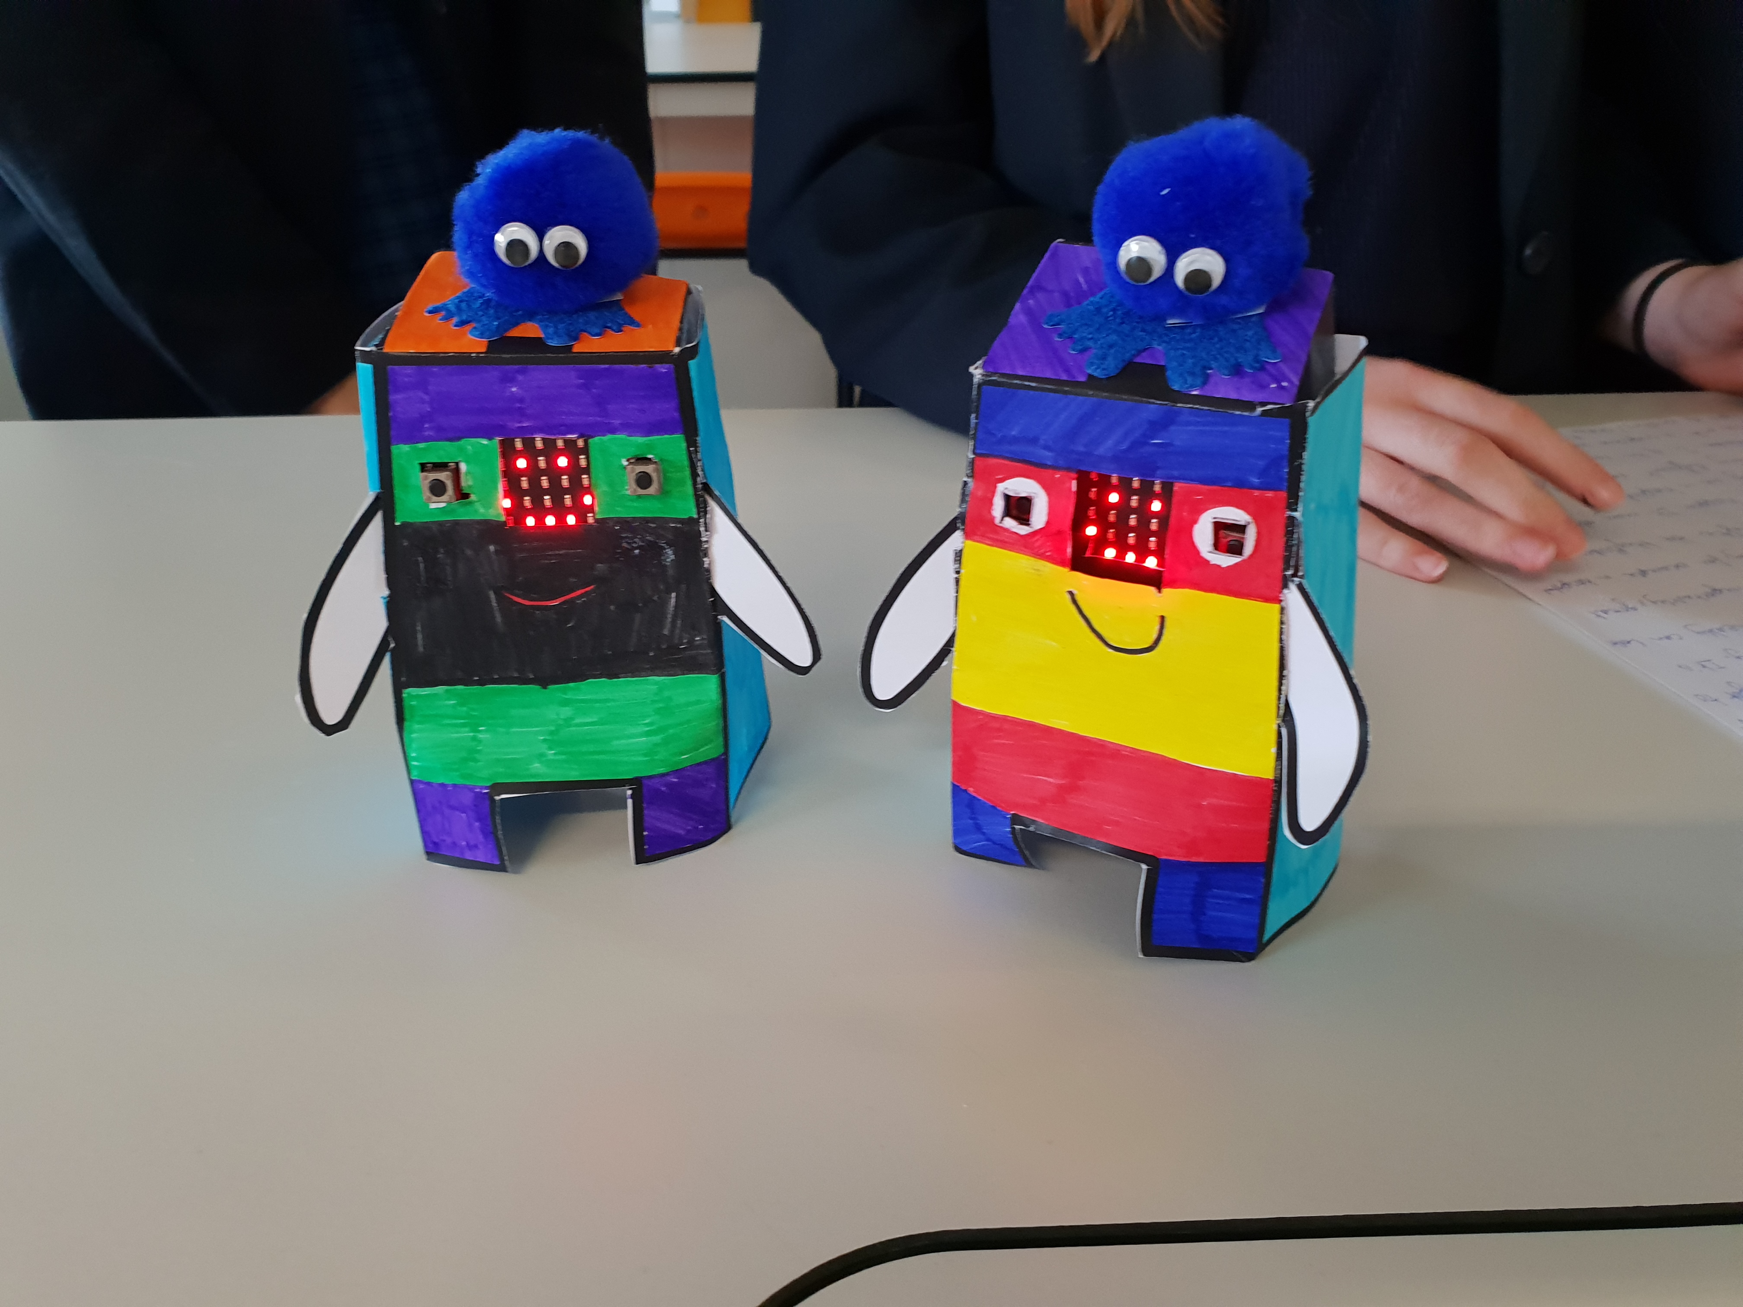
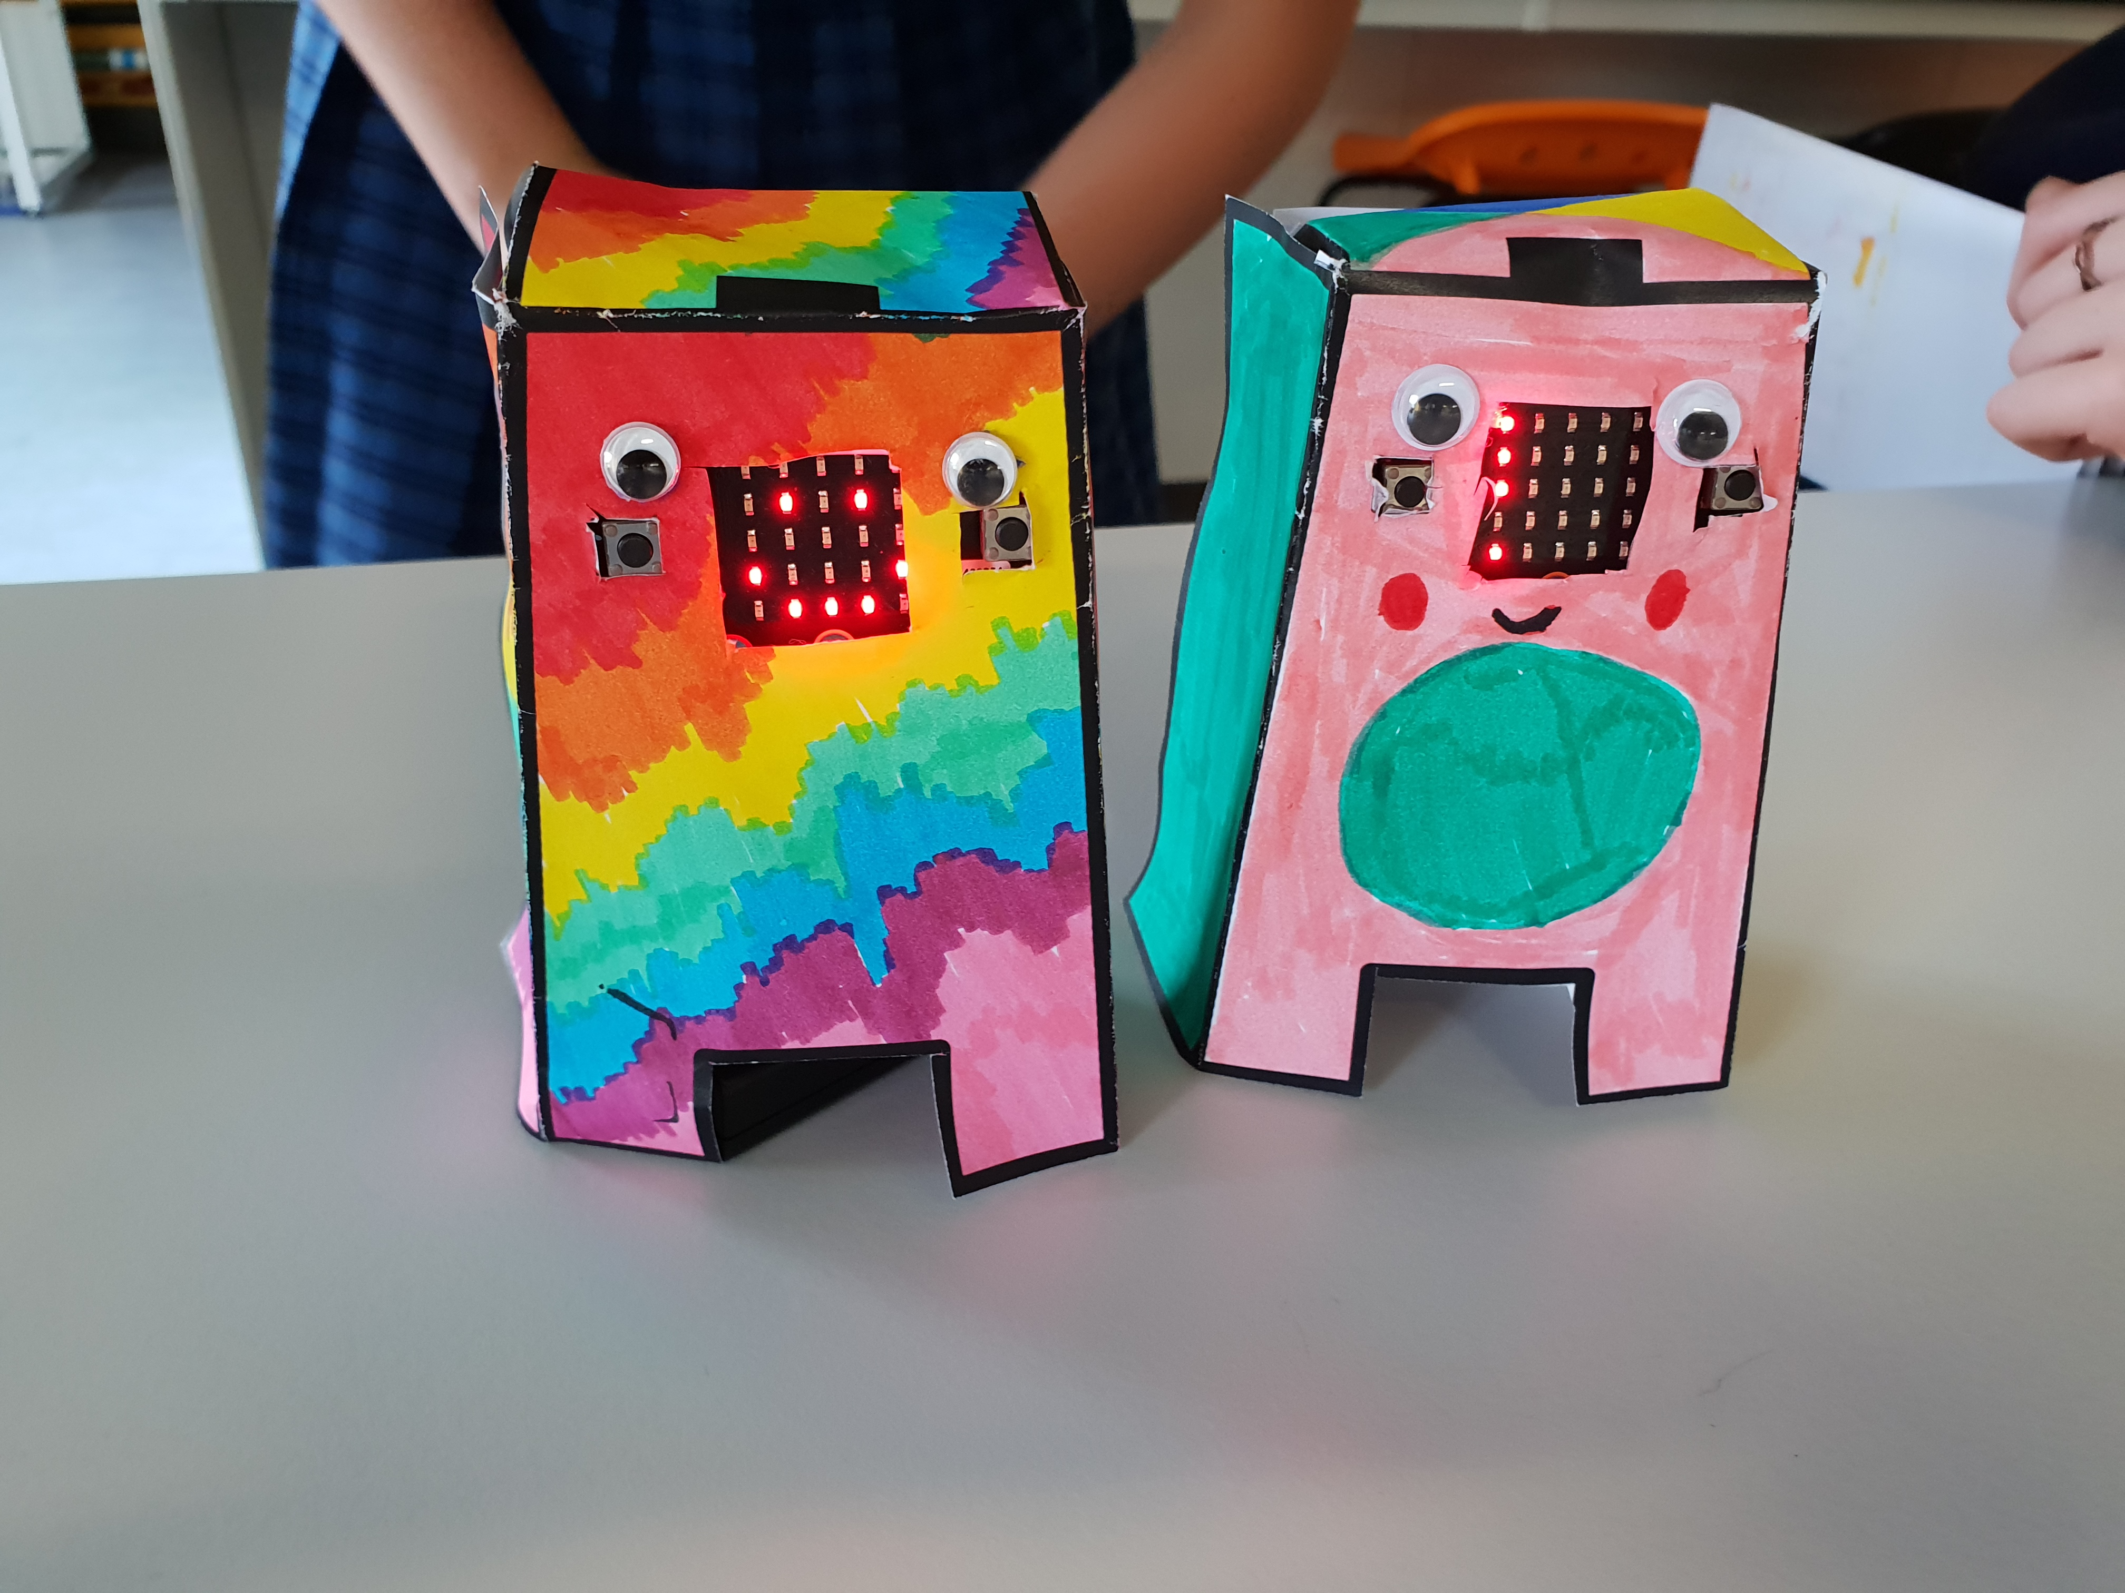
Setting the Scene
Loneliness is a real problem for children staying in hospitals for a long time
You need to create a digital pet that they can play with and keep them company while they stay in hospital

Slide 8
The Project
In groups you will need to:
Design and build a micro:pet
Design a program for a micro:bit to make the micro:pet interactive
Create a logo for your pet
Create an “elevator pitch” to present to your teacher

Slide 9
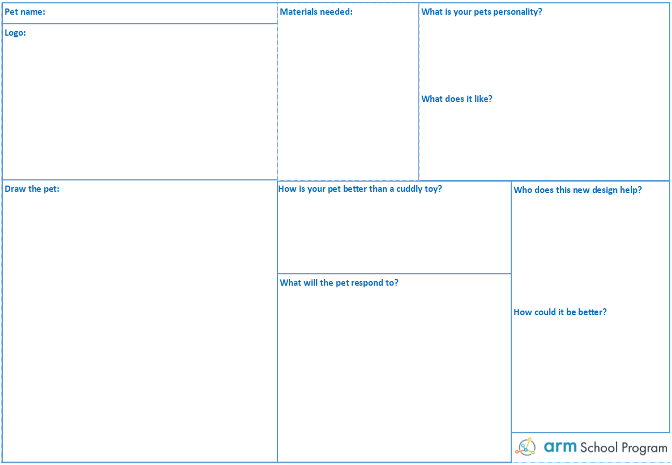
The Design Template
Fill this in first!
Add to it as you go along

